Slide 1
The Basic
Scala

Slide 2
Declaring Values and Variables
Var
Val
val greeting: String = null
val greeting: Any = "Hello"

Slide 3
Commonly Used Types
Byte, Char, Short, Int, Long, Float, and Double, and a Boolean type.
There is no distinction between primitive types and class types in Scala.
RichInt, RichDouble, RichChar, and so on.
To
1 to 10
scala.collection.immutable.Range
Inclusive
Notes:
"Hello".intersect("World") // Yields "lo"
In this expression, the java.lang.String object "Hello" is implicitly converted to a StringOps object, and then the intersect method of the StringOps class is applied.
Similarly, there are classes RichInt, RichDouble, RichChar, and so on.

Slide 4
Arithmetic and Operator Overloading
+ - * / %
a + b
is a shorthand for
a.+(b)

Slide 5
More about Calling Methods
"Hello".intersect("World")
"Bonjour".sorted // no parameters
The rule of thumb is that a parameterless method that doesn’t modify the object has no parentheses. We discuss this further in Chapter 5.
import scala.math._
sqrt(2)
you can import the package and use the methods of the package object without any prefix
scala.math.sqrt(2)

Slide 6
The apply Method
Example
Val s = “hello”
s(4) //yields ‘o’
It is implemented as a method with the name apply.
Def apply( n: Int): Char
This is a shortcut for
s.apply(4)
Notes:
This argument is even more convincing for maps. As you will see in Chapter 4, you look up a map value for a given key as map(key). Conceptually, a map is a function from keys to values, and it makes sense to use the function notation.

Slide 7
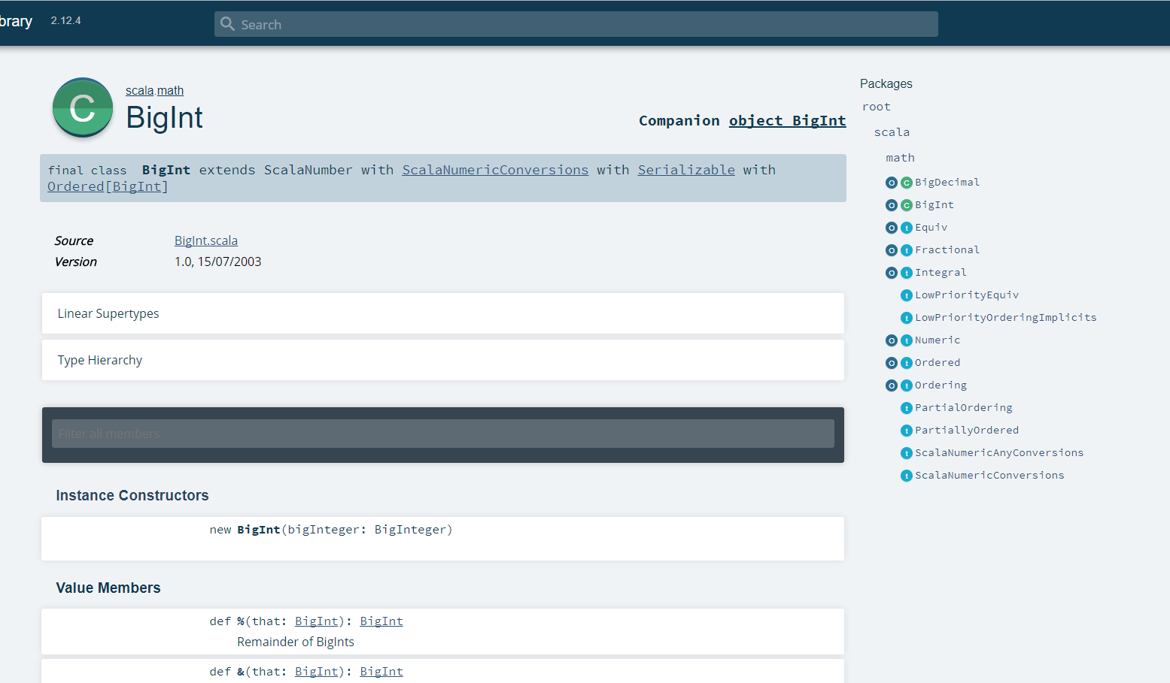
Scaladoc
http://scala-lang.org/download/

Slide 8
Question
"hello".toCharArray foreach(print) //ok
hello" toCharArray foreach(print) //not
"hello world" substring(0, 3) toUpperCase() indexOf "h“ // ok

